Slide 1
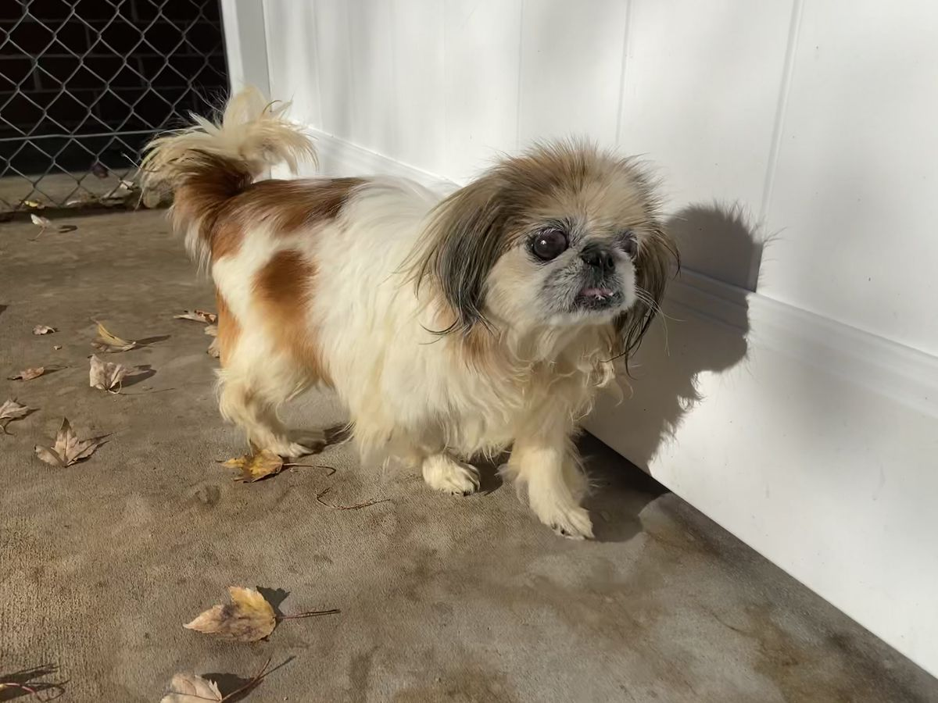
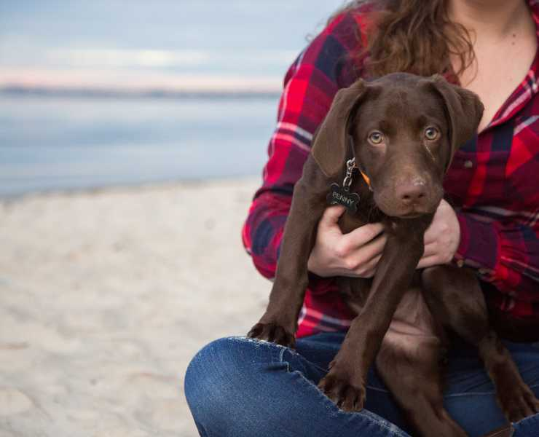
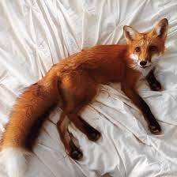
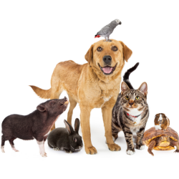
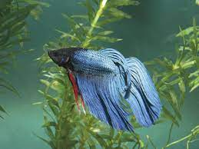

PetForo
Filter By:
Search Pets
Pets Nearby: 30 miles
Account
Create Offer
Active Posts
Home
Inbox

Slide 2

PetForo
Messages
Jeffrey Dahmer
NEW!
Hello, has your pet had any previous owners besides yourself?
Jeffrey Epstein
How big is the fishbowl?
Jeffrey Bezos
I’d like to buy your dog for $750.00
Account
Create Offer
Active Posts
Home
Inbox

Slide 3
PetForo
Post a Pet!
Upload Photos: 10 Max
Title
Age
Spayed / Neutered
Species
Breed
years
True / False
Fox
Location
Purebred
True / False
Account
Create Offer
Active Posts
Home
Inbox

Slide 4
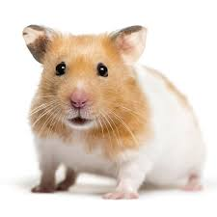
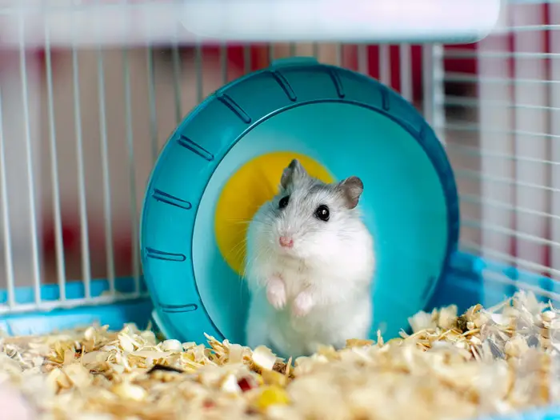
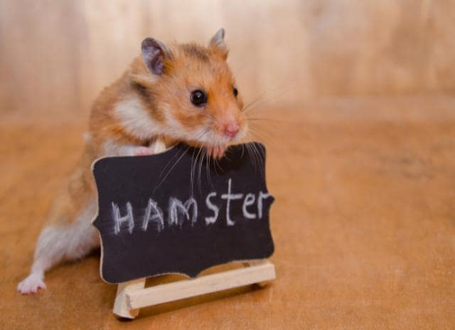
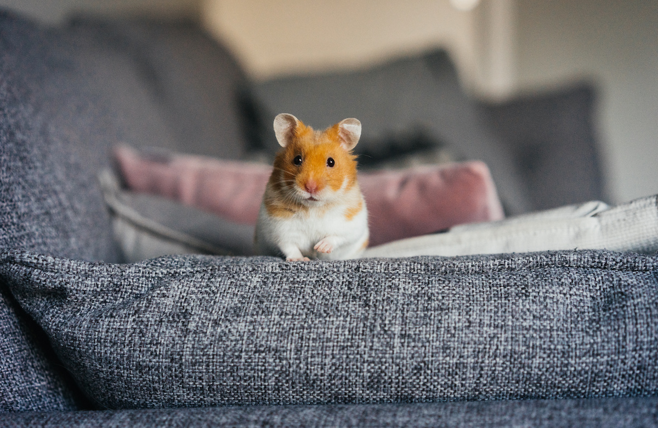
PetForo
Filter By: Location
Search Pets: Hamsters
Showing Hamsters Nearby
Show More
Account
Create Offer
Active Posts
Home
Inbox

